Slide 1
UNIT-IV
Arithmetic
Prepared by Ravi Kalkundri
Department of CSE, KLS GIT

Slide 2
Outline
A basic operation in all digital computers is the addition or subtraction of two numbers.
ALU – AND, OR, NOT, XOR
Unsigned/signed numbers
Addition/subtraction
Multiplication
Division
Floating number operation (SELF LEARING)

Slide 3
Adders

Slide 4
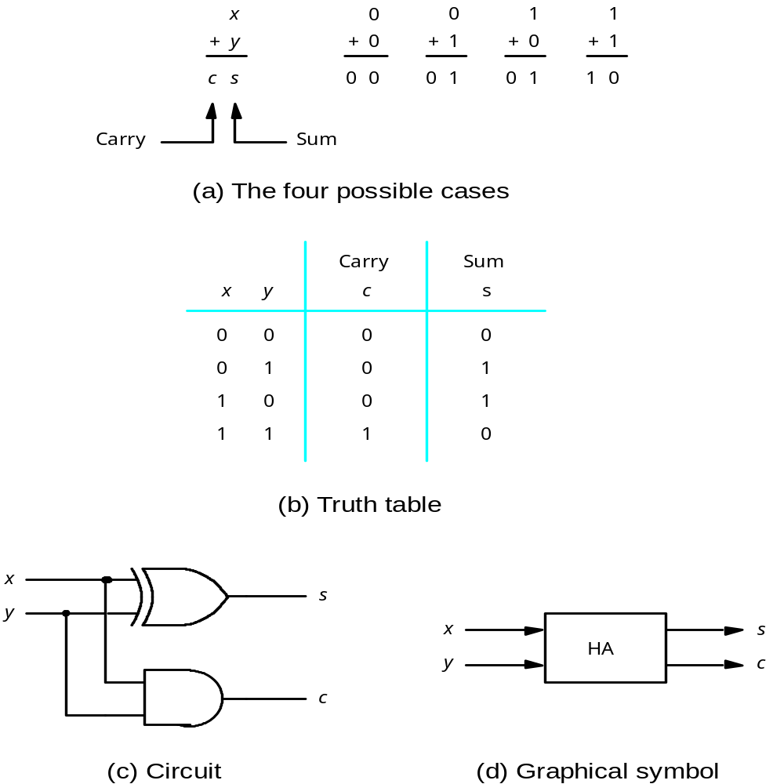
Addition of Unsigned Numbers – Half Adder

Slide 5
Addition and Subtraction of Signed Numbers
x
i
y
i
Carry-in
c
i
Sum
s
i
Carry-out
c
i
+1
0
0
0
0
0
0
0
1
1
0
0
1
0
1
0
0
1
1
0
1
1
0
0
1
0
1
0
1
0
1
1
1
0
0
1
1
1
1
1
1
s
=
x
y
c
+
x
y
c
+
x
y
c
+
x
y
c
=
x
i
⊕
y
i
⊕
c
i
i
i
i
i
i
i
i
i
i
i
i
i
i
c
=
y
c
+
x
c
+
x
y
i
+1
i
i
i
i
i
i
E
xample:
X
7
0
1
1
1
Carry-out
x
i
Carry-in
+
Y
=
+ 6
=
+
0
0
1
1
1
1
0
0
0
c
y
i
c
Z
13
1
1
0
1
i
+1
s
i
i
Legend for stage
i
Figure 6.1. Logic specification for a stage of binary addition.

Slide 6
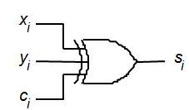
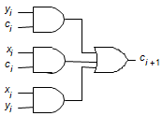
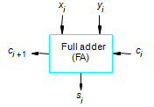
Addition and Subtraction of Signed Numbers
A full adder (FA)
A Logical expression of stage ‘i’ is show with three input XOR gate.
The carry-out ci+1 is implemented with two level AND-OR Logic circuit.
We can also have a convenient symbol for the complete circuit for a single stage of addition, called a Full Adder (FA)

Slide 7
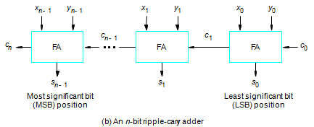
Addition and Subtraction of Signed Numbers
A cascaded connection of n Full Adder blocks is shown below.
As the carry propogates, or ripples through the cascaded FA’s called as n-bit ripple-carry adder
Overflow?
Figure 6.2.

Slide 8
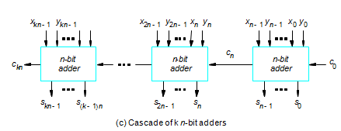
Addition and Subtraction of Signed Numbers
The carry signals are also useful for interconnecting ‘k’ adders to form a adder capable of handling inputs numbers that are k nbit long.
kn-bit ripple-carry adder
Figure 6.2. Logic for addition of binary vectors.

Slide 9
Addition and Subtraction of Signed Numbers
Then-bit adder in Figure 6.2b can be used to add 2's-complement numbers X and Y, where the x_{n-1} and y_{n-1} bits are the sign bits.
In this case the carry-out bit c_{n} is not part of the answer.
And overflow obviously occurs if the sign of the result is different.
Therefore, a circuit to detect overflow can be added to the n-bit adder by implementing the logic expression.
It can also be shown that overflow occurs when the carry bits c. and c_{n-1} are different.
Therefore; a simpler alternative circuit for detecting overflow can be obtained by implementing the expression: c_{n} c_{n-1} with a XOR gate.
+

Slide 10
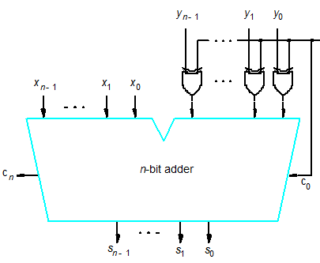
Addition and Subtraction of Signed Numbers
Addition/subtraction logic unit
In order to perform the subtraction operation X - Y op 2's-complement numbers X and Y, we form the 2's-complement of Y and add it to X.
The logic circuit network shown in Figure 6.3 can be used to perform either addition or subtraction based on the value applied to the Add/Sub input control line.
6.3 Binary addition-subtraction logic network

Slide 11
6.2 Make Addition Faster

Slide 12
6.2 Ripple-Carry Adder (RCA)
Straight-forward design
Simple circuit structure
Easy to understand
Most power efficient
Slowest (too long critical path)
Delay in developing its outputs, s_{o} through s_{n-i} and c_{n}.
Delay caused by combinational logic network constructed from gates along the path through the network.
In the case of the n-bit ripple-carry adder, the longest path is from inputs x₀, yo, and c₀ at the LSB position to outputs c_{n} and s_{n-i} at the most-signific.ant-bit (MSB) position.

Slide 13
6.2 Ripple-Carry Adder (RCA)
Two approaches to reduce delay in adders:\
  Use the fastest possible electronic technology in implementing the ripple-carry logic design or variations of it.
  Use an augmented logic gate network structure that is larger than that shown in Figure 6.2b

Slide 14
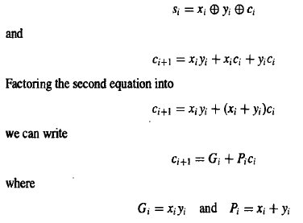
6.2.1 Carry-lookahead Logic
A fast adder circuit must speed up the generation of the carry signals.
The logic ex­ pressions for s; (sum) and c_{i+l} (carry-out) of stage i (see Figure 6.1) are
The expressions G_{i} and P_{i} are called the generate and propagate functions for stage i.
If stage i=1, then c_{i+l} = 1, independent of the input carry, c_{i}.
This occurs if x_{i} =1 & y_{i} =1.
Each bit stage contains an AND gate to form G_{i}, an OR gate to form P_{i}, and a three-input XOR gate to form s_{i}.

Slide 15
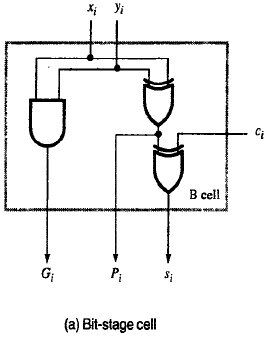
6.2.1 Carry-lookahead Logic
Each bit stage contains an AND gate to form G_{i}, an OR gate to form P_{i}, and a three-input XOR gate to form s_{i}.
A simpler circuit can be derived by observing that an adequate propagate function can be realized as
  P_{i} = x_{i} y_{i}, which differs from
  P_{i} = x_{i} + y_{i} only when x_{i} = y_{i} = 1.
But, in this case G_{i} = 1, so it does not matter whether P_{i} is O or 1.
Then, using a cascade of two 2-input XOR gates to realize the 3-input XOR function, the basic cell B in Figure 6.4a can be used in each bit stage
+

Slide 16
6.2.1 Carry-lookahead Logic
Expanding c_{i} in terms of i-1 subscripted variables and substituting into the c_{i+1} expression, we obtain
c_{i+1} = G_{i} + P_{i} G_{i-1} + P_{i} P_{i-1} c_{i -1}
Let us consider the design of a 4-bit adder. The carries can be implemented as

Slide 17
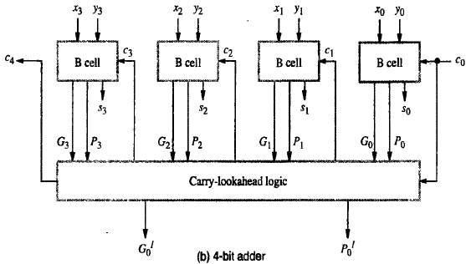
6.2.1 Carry-lookahead Logic
Let us consider the design of a 4-bit adder. The carries can be implemented as
An adder implemented in this form is called a carry-lookahead adder.
Delay through the adder is 3 gate delays for all carry bits and 4 gate delays for all sum bits.
C₁ = G₀ + P₀ C₀
C₂ = G₁ + P₁ C₁ = G₁ + P₁ G₀ + P₁ P₀ C₀
C₃ = G₂ + P₂ C₂ = G₂ + P₂ G₁ + P₂ P₁ G₀ + P₂ P₁ P₀ C₀
C₄ = G₃ + P₃ C₃ = G₃ + P₃ G₂ + P₃ P₂ G₁ + P₃ P₂ P₁ G₀ + P₃ P₂ P₁ P₀ C₀

Slide 18
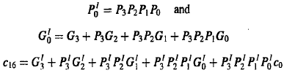
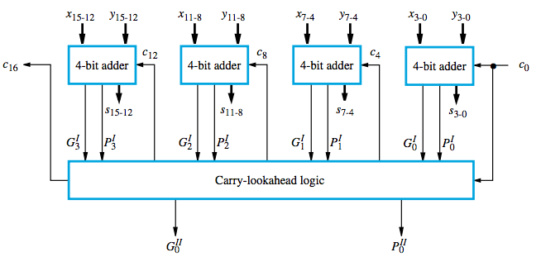
6.2.1 Carry-lookahead Logic
Figure 6.5 shows a 16-bit adder built from four 4-bit adder blocks. These blocks provide new output functions defined G¹_{k} and P¹_{k} where k=0 for the first 4 bits
Figure 6.5 16-bit carry-lookahead adder built from 4-bit adders (see Figure 6.4b).

Slide 19
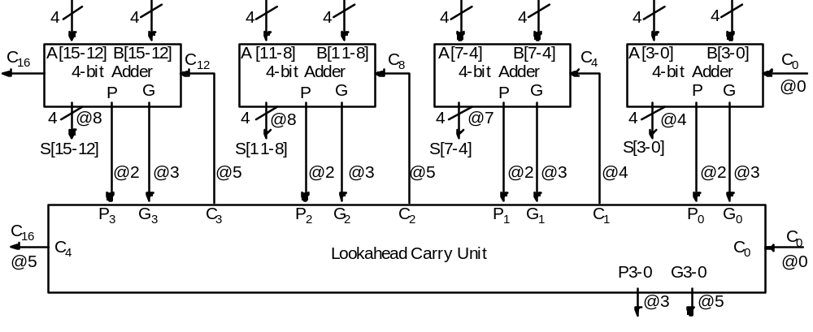
Carry-lookahead Logic
4 bit adders with internal carry lookahead
second level carry lookahead unit, extends lookahead to 16 bits
Group Propagate P = P₃ P₂ P₁ P₀
Group Generate G = G₃ + G₂P₃ + G₁P₃P₂ + G₀P₃P₂P₁

Slide 20
6.3 Unsigned Multiplication

Slide 21
Manual Multiplication Algorithm
1
1
0
1
(13) Multiplicand M
×
1
0
1
1
(11) Multiplier Q
1
1
0
1
1
1
0
1
0
0
0
0
1
1
0
1
1
0
0
0
1
1
1
1
(143) Product P
(a) Manual multiplication algorithm

Slide 22
Array Multiplication
Binary multiplication of positive operands can be implemented in a combinational, two-dimensional logic array, as shown in Figure6.6b.
The main component in each cell is a full adder FA.
The AND gate in each cell determines whether a multiplicand bit, m_{j} is added to the incoming partial-product bit
Bit of incoming partial product (PP
i
)
m
j
q
i
T
ypical cell
Carry-out
F
A
Carry-in
Bit of outgoing partial product [PP(
i
+1)]
(b) Array implementation

Slide 23
Array Multiplication
Multiplicand
P
artial product
0
m
3
0
m
2
0
m
1
0
m
0
(PP0)
q
0
0
p
0
PP1
q
1
0
p
1
Multiplier
PP2
q
2
Bit of incoming partial product (PP
i
)
m
0
j
PP3
p
2
q
3
q
i
0
T
ypical cell
p
7
p
6
p
5
p
4
p
3
PP4 =
p
,
p
, ...
p
= Product
Carry-out
F
A
Carry-in
7
6
0
Bit of outgoing partial product [PP(
i
+1)]
(b) Array implementation

Slide 24
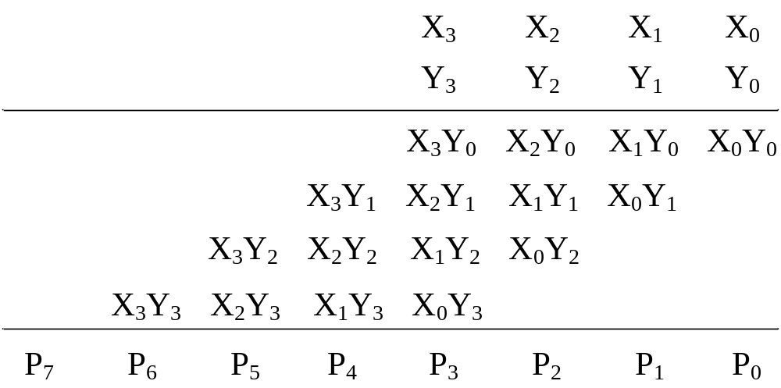

Slide 25
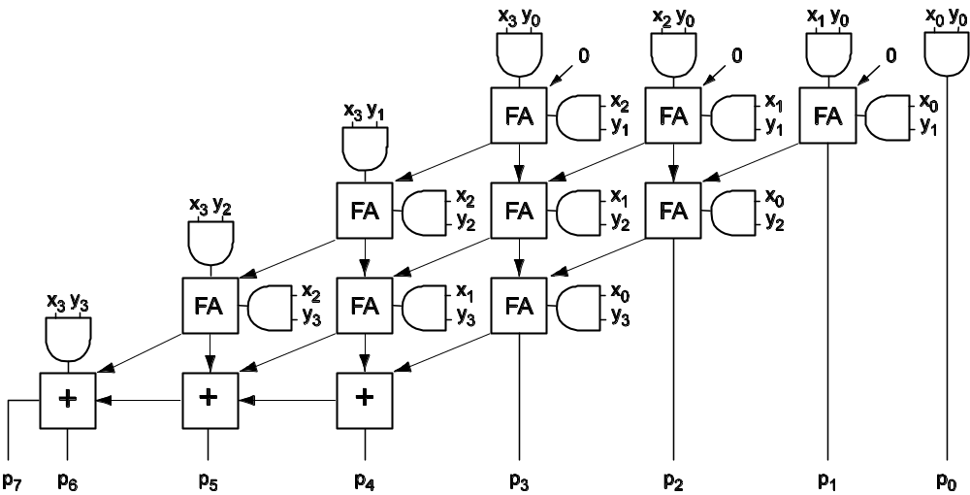
Another Version of 4×4 Array Multiplier

Slide 26
Array Multiplication
What is the critical path (worst case signal propagation delay path)?
Assuming that there are two gate delays from the inputs to the outputs of a full adder block, the path has a total of 6(n-1)-1 gate delays, including the initial AND gate delay in all cells, for the n×n array.
Any advantages/disadvantages?

Slide 27
Sequential Circuit Binary Multiplier
Register A (initially 0)
M
Shift right
1 1 0 1
Initial configuration
a
a
q
q
0
0 0 0 0
1 0 1 1
C
n
-
1
0
n
-
1
0
C
A
Q
Multiplier Q
0
1 1 0 1
1 0 1 1
Add
First cycle
Add/Noadd
0
0 1 1 0
1 1 0 1
Shift
control
1
0 0 1 1
1 1 0 1
Add
Second cycle
0
1 0 0 1
1 1 1 0
Shift
n
-bit
0
1 0 0 1
1 1 1 0
No add
adder
0
0 1 0 0
1 1 1 1
Shift
Third cycle
MUX
Control
sequencer
1
0 0 0 1
1 1 1 1
Add
Fourth cycle
0
0
0
1 0 0 0
1 1 1 1
Shift
m
n
-
1
m
0
Product
Multiplicand M
(b) Multiplication example
(a) Register configuration

